Slide 1
CS/IT BSc Projects
Ubiquitous Computing and Interaction

Slide 2
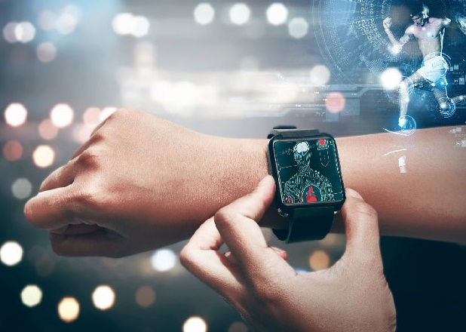
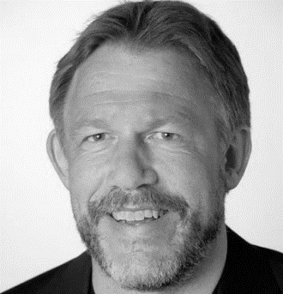
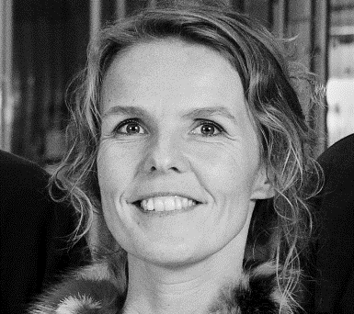
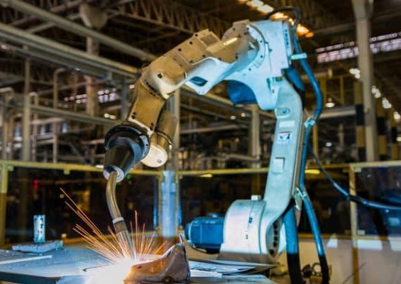
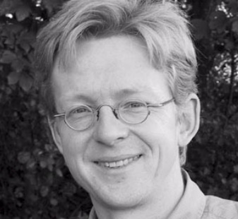
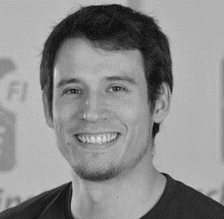
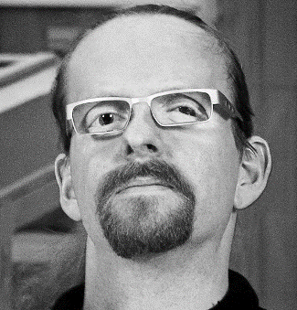

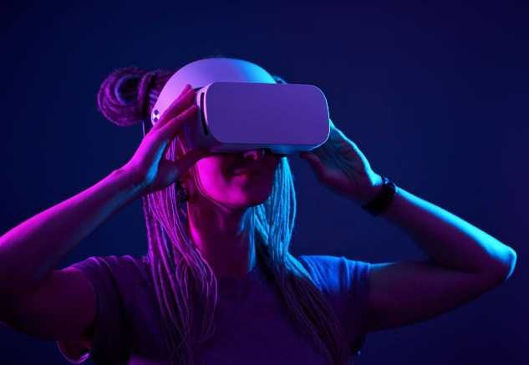
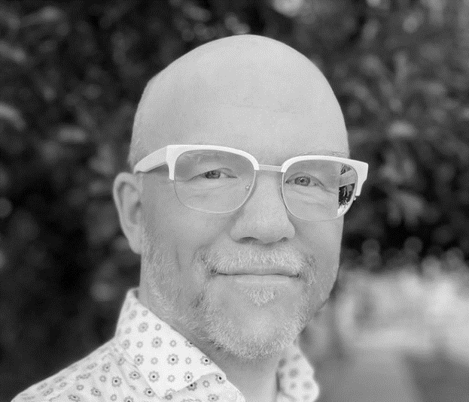
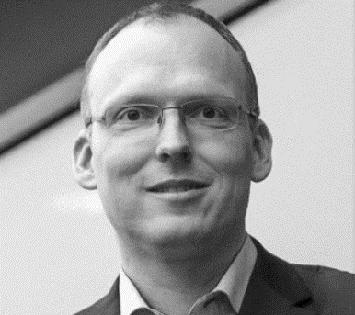

KAJ
MARIANNE
HANS
KEN
NIELS OLOF
NIKLAS
HANS-JÖRG

Slide 3
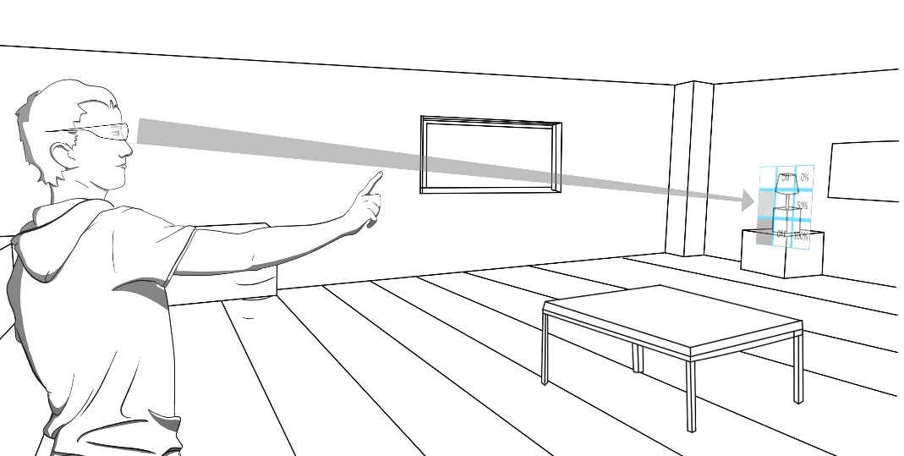
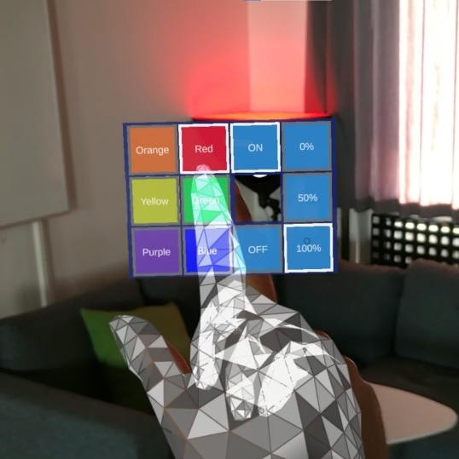
[UBI-B] Novel AR Interfaces for IoT Devices
How to interface with smart environments and IoT enabled devices through AR?
How to augment real objects with virtual user interfaces?
Notes:
Remote Manipulation; Drag & Drop in Space

Slide 4
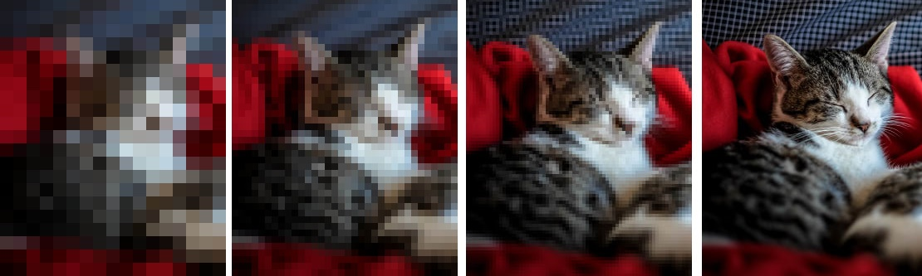
[UBI-H] Progressive Visualization Techniques
Progressive JPEG
Progressive Visualization

Slide 5
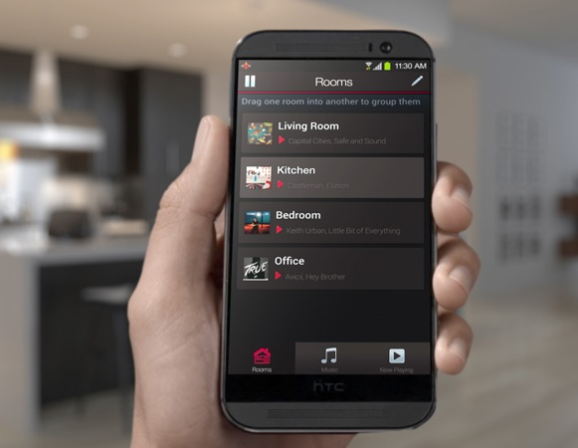
[UBI-K] Seamless Music Streaming
Transitions
Room to Room
Phone to Stereo
Playlist A to Playlist B
Sensors for spatial, temporal, and social context

Slide 6
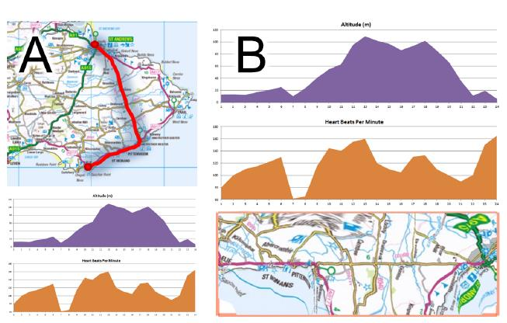
[UBI-E] TimeRibbons: Spatiotemporal Visualization
How to compare trajectories in space & time?
Use Google Maps + WebGL to distort geospacer so that it aligns with the timeline

Slide 7
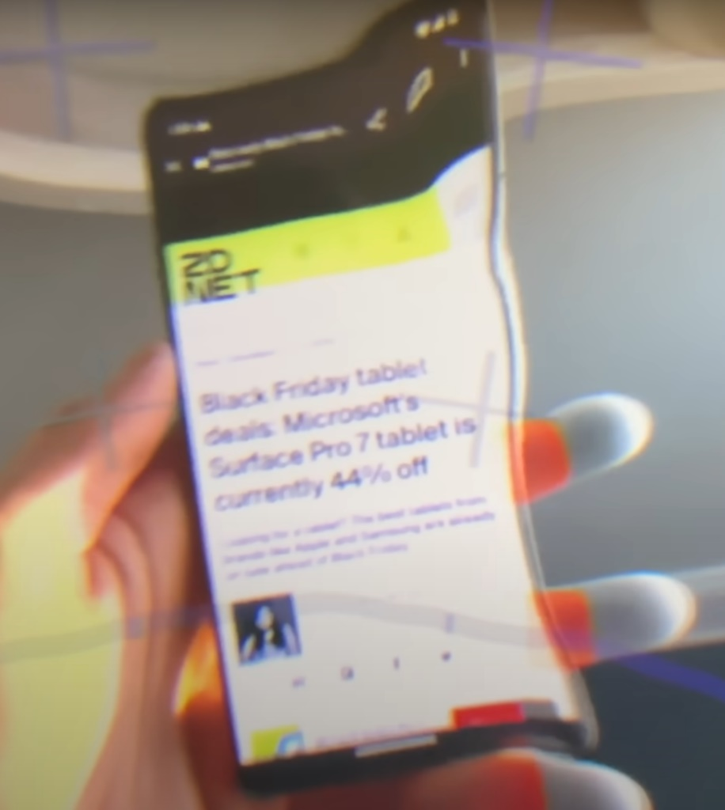
[UBI-D] Exploring the Layers of Mixed Reality
How to mix virtual content and real screens?
How to interact consistently with mixed content in MR?
How to use gaze tracking across different layers of reality?
Notes:
Video passthrough MR

Slide 8
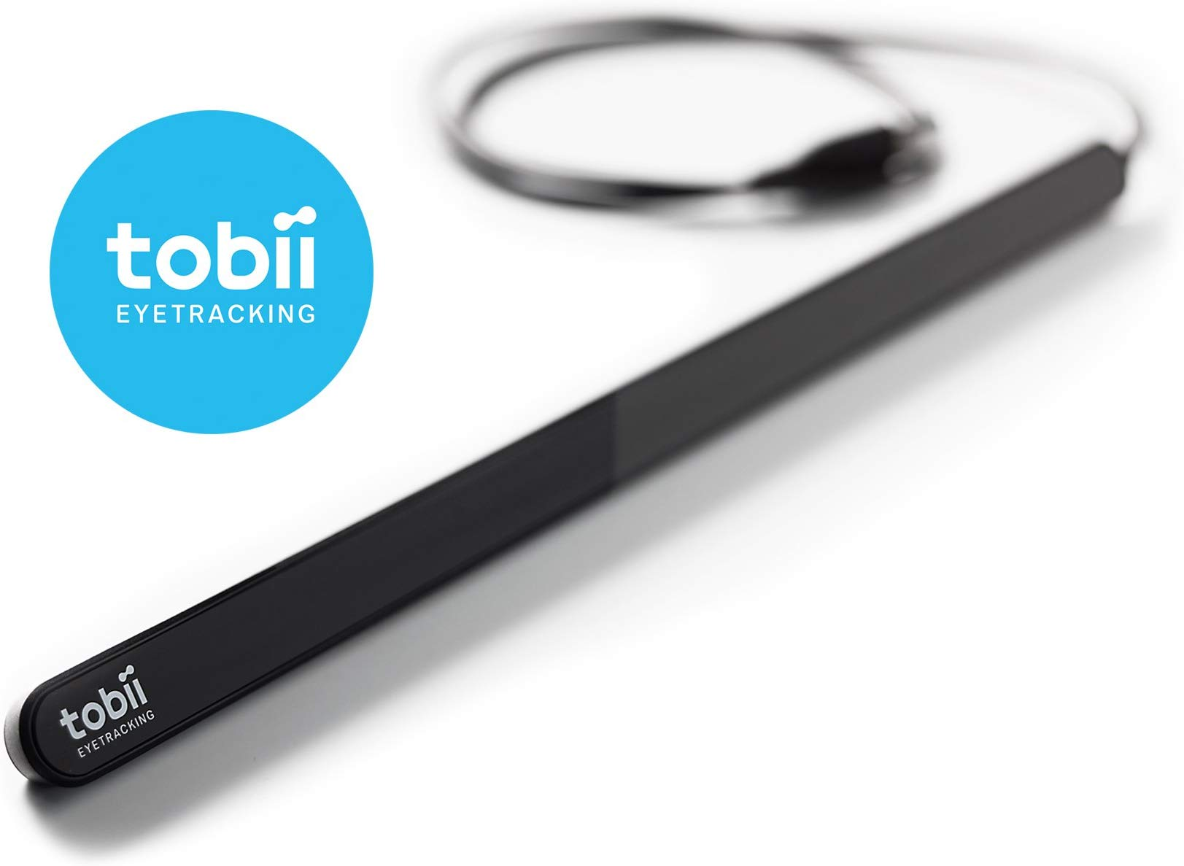
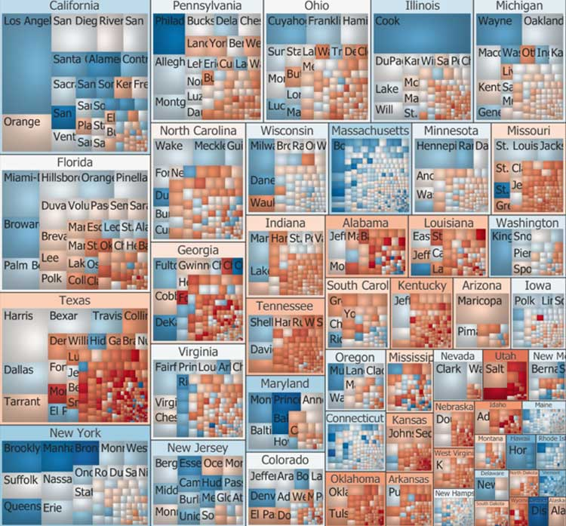
[UBI-J] Focus&Context Visualization through Eye Tracking
How to adjust the Level of Detail of a visualization by merely looking at it?

Slide 9
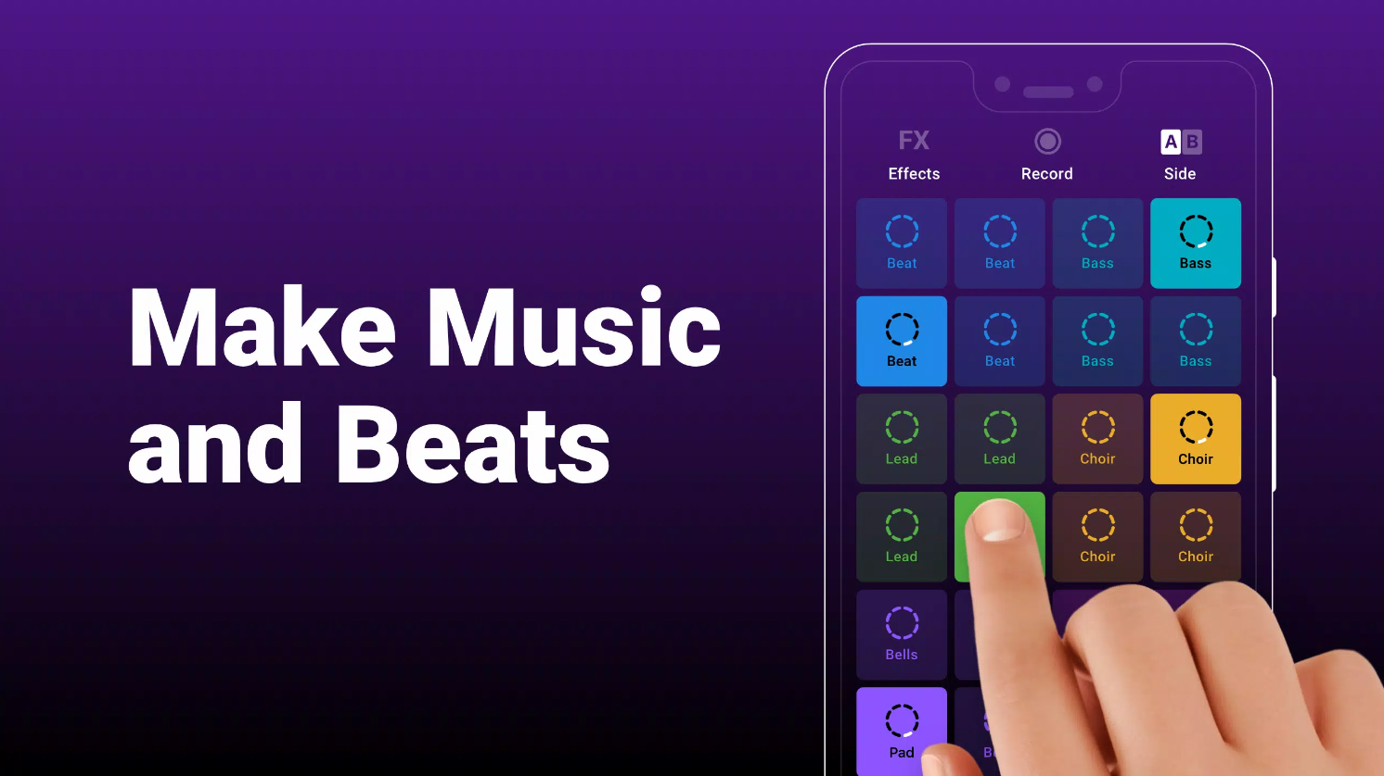
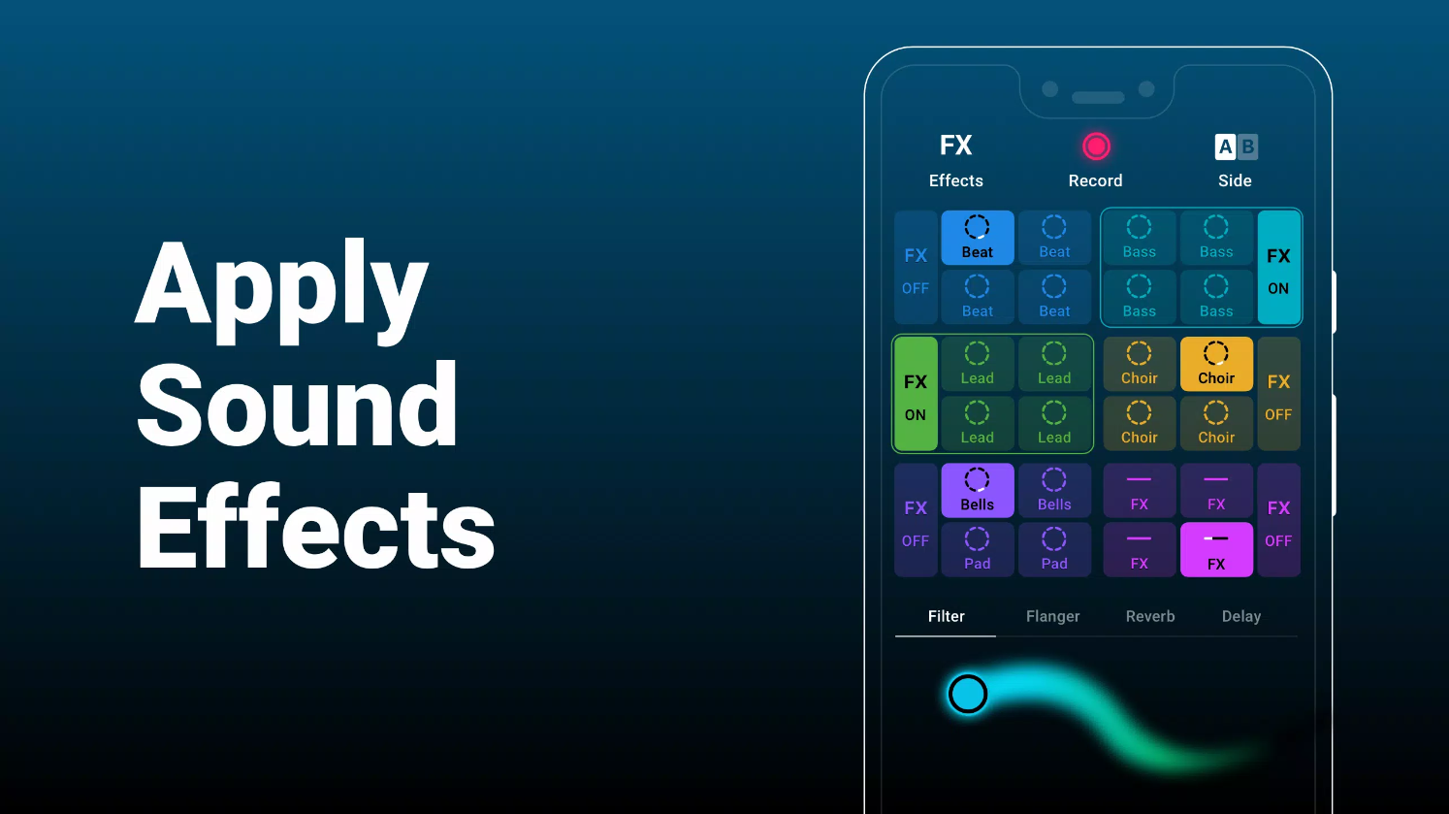
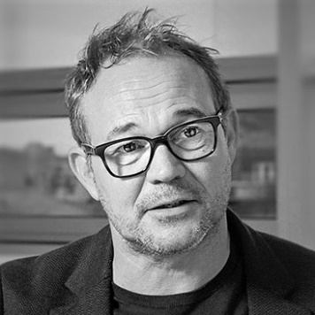
[UBI-M] Collective Interaction – Performative Music Playing
How to connect a disconnected society through collaborative music making?
Peter Gall Krogh
Socio-technical Design Group
Department of Communication & Culture

Slide 10
UBI BSc Projects
If you want to know more come to the information meeting right after or drop me an email at hjschulz@cs.au.dk.

